Slide 1
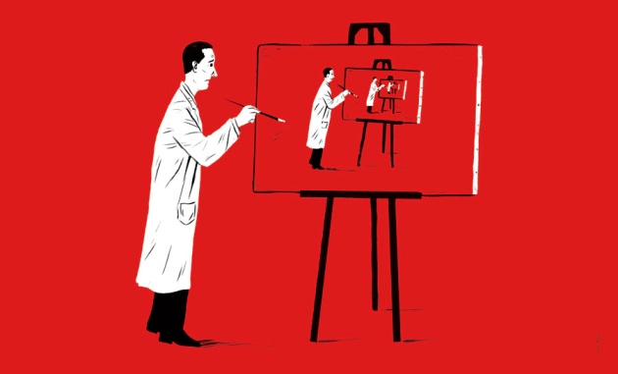

Contextual sensitivity
in reproducibility
William J. Brady

Slide 2
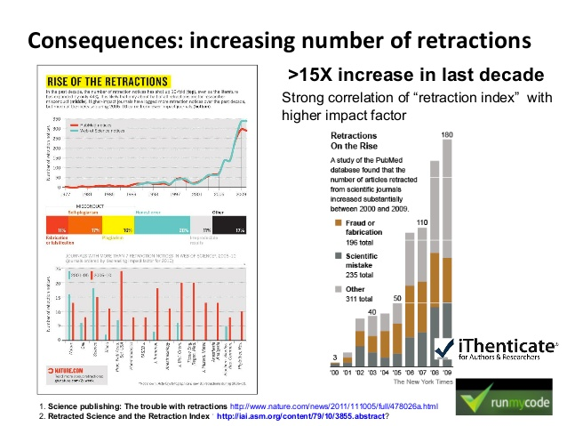
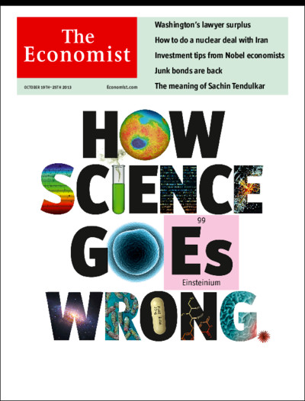
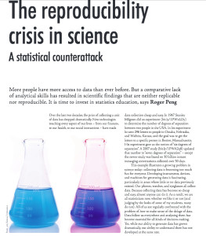
A scientific crisis
Notes:
With retractions, replication failures, and exposure of questionable research practices on the rise, it’s no surprise that fields across all scientific domains are taking initiative to deal with this, as this really exciting symposium demonstrates.

Slide 3

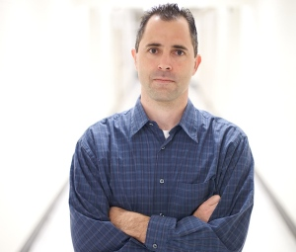
The Reproducibility Project
Selected 100 studies in top journals
Assigned 270 researchers to conduct direct replications
Notes:
Perhaps one of the most well-known recent replication attempts came from the Center for Open science, with an initiative to estimate the reproducibility of psychological science. The team selected 100 studies in top psychology journals and 270 researchers collaborated to conduct direct replications of specific effects in psychology.

Slide 4
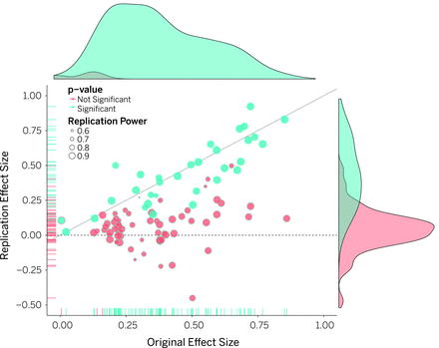
The Reproducibility Project
Notes:
This may be one of the most well-known massive replication attempts because of the striking results. On the x axis you see the effect size of the original study, and on the y axis you see the effect size of the replication. In pink are studies that failed to achieve significance in the replication. As you can see in this figure, a large number of replication attempts yielded non-significant results.

Slide 5
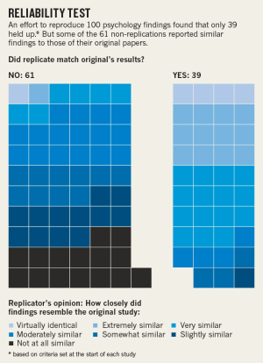
The Reproducibility Project
REPLICATION
36% (p < .05)
39% (judgment)
47% (within Cls)
Notes:
To put this more precisely, the study found that only 36% of studies successful replicated, if using a criteria of whether the replication attempt revealed a significant result. The percentages were slightly higher when using a criteria of whether or not the original study effect size was in the confidence interval of the replication study effect size. At any rate, this study painted a sobering picture of the effects in psychology.

Slide 6
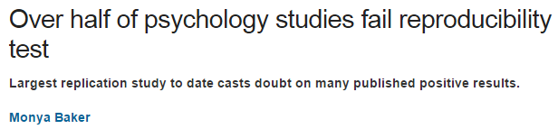
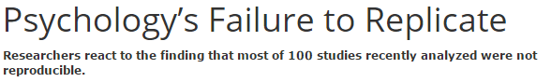
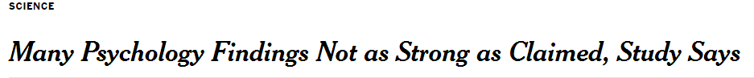
The Reproducibility Project
Media coverage (NYTimes, Guardian)
Policy implications (NRA, Climate change)
Notes:
And of course the media ran with these numbers and proclaimed that over half of psychology studies will not replicate. Along with the negative press, it created a negative picture of science for those in government organizations unsure of the usefulness of science to inform policy. If our studies aren’t replicating, why should we spend money funding these projects?

Slide 7
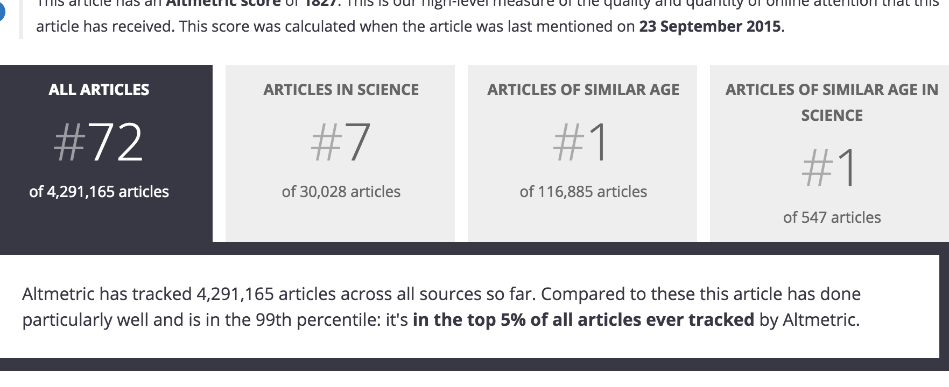
The Reproducibility Project
Notes:
It wasn’t just the media who ran with this project. This article was one of the most discussed and most read articles in the entire scientific community last year. According to Altmetrics, it was in the top 5 most discussed articles of the year.

Slide 8
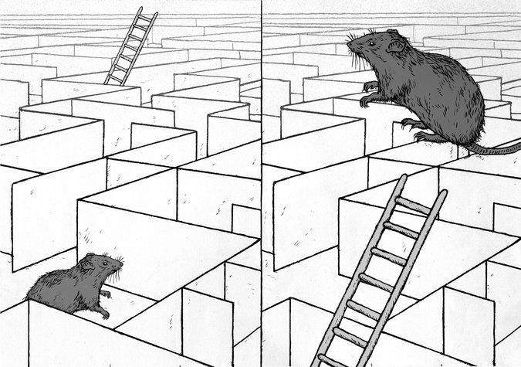
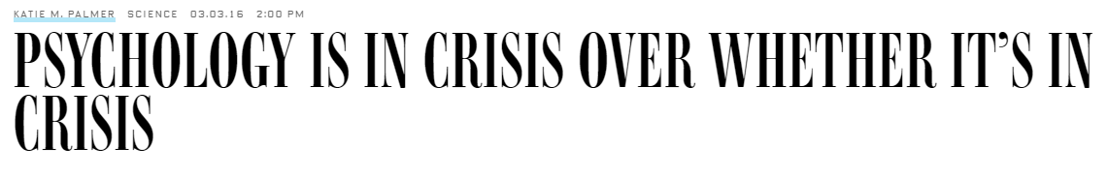
The Reproducibility Project
Notes:
Of course, there was a backlash against the findings in our field, some arguing that there were fundamental flaws with the replication studies, arbitrary criteria chosen, poor communication with original authors, and more.

Slide 9
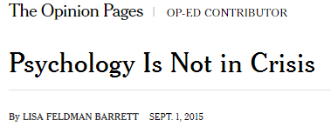
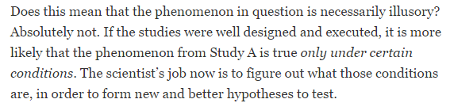
The Reproducibility Project
Notes:
But of special interest to us was the claim from prominent social psychologists that one important reason replication attempts in psychology fail is because of hidden moderators. As they wrote, “READ”. In short, context matters for studying any psychological effect.

Slide 10
The Reproducibility Project
Hidden moderators debate
“It is disturbingly common to hear people argue that the reason a study does not replicate is because of subtle differences in the setting, sample, or demeanor of the experimenter across labs. “ -Brent Roberts
Notes:
There were also many who found this line of argument disturbing, however. These replication attempts are supposed to be “direct replications”, and so subtle differences shouldn’t necessarily matter. And this bring us to our study. We wanted to empirically test, using the data set of 100 studies from the reproducibility project, whether the contextual sensitivity of an effect really does impact its replication success.

Slide 11
Contextual sensitivity
We coded 100 studies on the extent to which the effect should be contextually sensitive
5-point scale, from 1 = context is not at all likely to affect results to 5 = context is very likely to affect results (alpha = .86).
Notes:
In order to do so, we had three coders (all researchers in social psychology; two graduate students and one postdoctoral student), who were blind to the results of the replication outcome, rate all 100 psychology studies on the extent to which the research topic was likely to be contextually sensitive (defined as varying in time, culture, or location). Contextual sensitivity ratings were made on a 5-point scale, from 1 = context is not at all likely to affect results to 5 = context is very likely to affect results (ICC = .86; Shrout & Fleiss, 1979).

Slide 12
Contextual sensitivity
We coded 100 studies on the extent to which the effect should be contextually sensitive
5-point scale, from 1 = context is not at all likely to affect results to 5 = context is very likely to affect results (alpha = .86).
Context was not expected to affect the results of a study on “extracting statistical regularities in sequences of visual stimuli” but was expected to affect the results of a study on “how diversity cues signal threat or safety for African Americans”.
Notes:
For instance, context was not expected to affect the results of a study on “extracting statistical regularities in sequences of visual stimuli” but was expected to affect the results of a study on “how diversity cues signal threat or safety for African Americans”.”

Slide 13
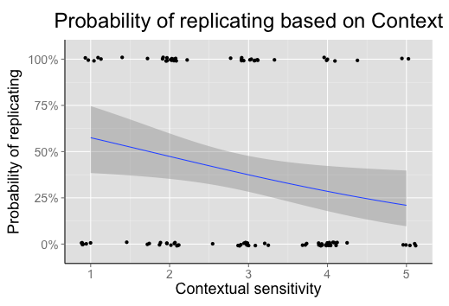
Contextual sensitivity
Contextual sensitivity correlated with replication success (r = -.23, p < .02)
Notes:
Now I’ll show you our man findings. On the x axis here you can see the values of our context variable, where higher values indicate greater contextual sensitivity. On the Y axis is the probability of replicating, represented here as a binary yes / no of whether the study replicated. We found a significant correlation between contextual sensitivity and replication success. As contextual sensitivity increased, replication success decreased. Of interest is that the effect of context on replication was not significantly different between social psychology and cognitive psychology, even though social psychology studies had a greater mean contextual sensitivity.
**Results via point-biserial correlation and binary logistic regression

Slide 14
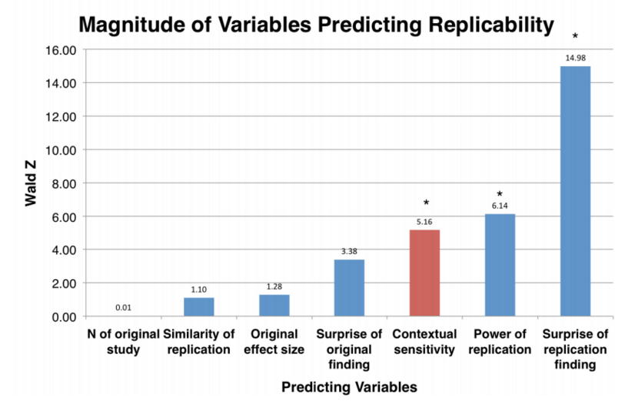
Contextual sensitivity
Contextual sensitivity correlated with replication success (p = .018) even after adjusting for methodological variables
Notes:
Importantly, we also showed that the relationship remained significant even after adjusting for characteristics of the original and replicated studies that were demonstrated to be correlated with replication success by the Reproducibility Project. These variables included for example (1) the effect size of the original study, (2) whether the original results were surprising, (3) power of the replication attempt, and (4) whether the replication result was surprising.

Slide 15
Contextual sensitivity
In a hierarchical regression, contextual sensitivity also accounted for significant variance (R2 change = .06, p = .01)
Notes:
Moreover, when these study characteristic variables were entered as a first step in a hierarchical regression model, and the contextual sensitivity variable was added in a second step, contextual sensitivity accounted for significant additional variance in replication success.

Slide 16
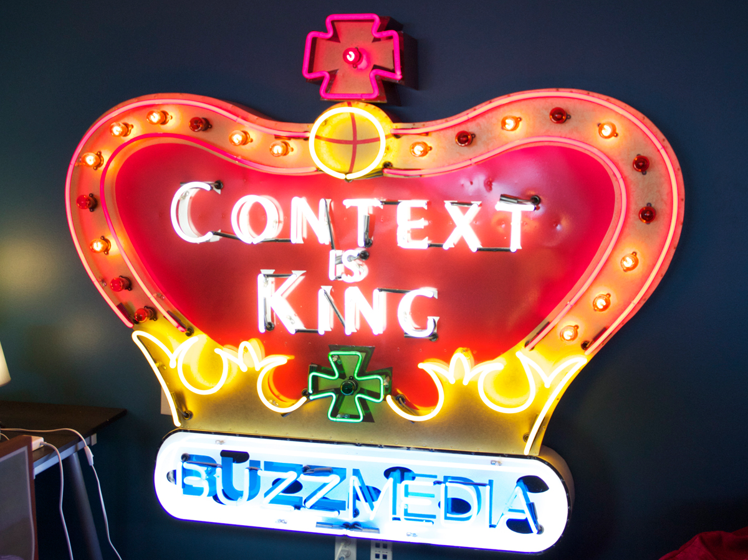
Context matters…even in direct replications
Notes:
Taken together, These results suggest that contextual sensitivity likely plays a key role in replication success, over-and-above several other important methodological variables.

Slide 17
Key lessons
We still need methodological improvements and better publication practices (power, publication bias, p-hacking)
But context remains important.
Notes:
So what do we take away from these findings? First, note that we still consider methodological improvements as fundamental to increasing replication success in science. Even our own data showed that that variables such as effect size and power were still significant predictors over and above contextual sensitivity. But context is also important.

Slide 18
Key lessons
Hidden moderators should not be blindly invoked as explanations for failed replications without theoretical rationale and empirical scrutiny.
Researchers should avoid making universal generalizations from limited data and be explicit as possible in defining the likely contextual boundaries of specific effects
Replicators should work closely and communicate clearly with original authors. Replications should be collaborative and not antagonistic if we are to move science forward.
Notes:
Here are some general recommendations for how to deal with contextual sensitivity moving forward.

Slide 19


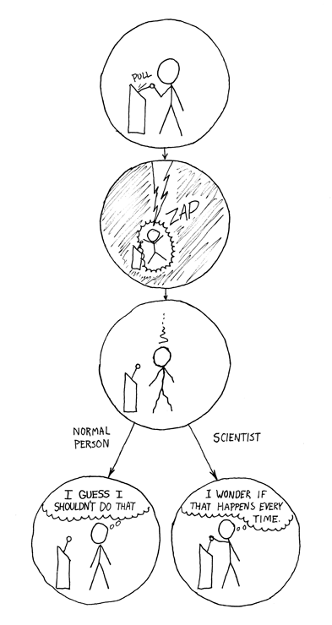


All data online via Open Science Framework: https://osf.io/cgur9//
@vanbavellab
@billysbrain
Collaborators: Jay Van Bavel, Peter Mende-Siedlecki, & Diego Reinero
Funding: SSHRC, NSERC, NSF, SSPSI
Notes:
OSF link will be made public around 5/15/16 (currently embargoed by journal)

Slide 20
Psychology: A case study
Power + Publication bias + P-hacking = Failure to replicate
Notes:
In my field of psychology, many have argued that some key factors are power of studies, publication bias and researcher bias as the formula for failure to replicate. But in this talk I’ll present our work that raises another factor – contextual sensitivity of the effects of interest.

Slide 21
Affective flexibility
Interesting in studying how goals shape evaluations (amygdala)
We presented participants with famous names (e.g., Hitler, Mother Theresa, Don Cherry)
People made positive, negative, or overall attitude judgments
Notes:
Show image of Don Cherry

Slide 22
Don Cherry Problem
How do we replicate this?
Don Cherry, John A. MacDonald, Karla Homolka
Is it meaningful to study affect with stimuli that don’t evoke affect or ambivalence?
A so-called direct replication is impossible
In this case, a conceptual replication is a direct replication.
Notes:
Show image of Don Cheery

Slide 23
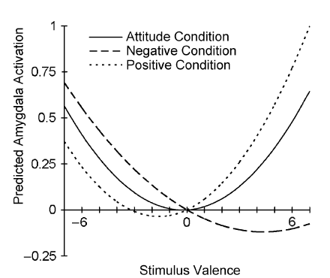
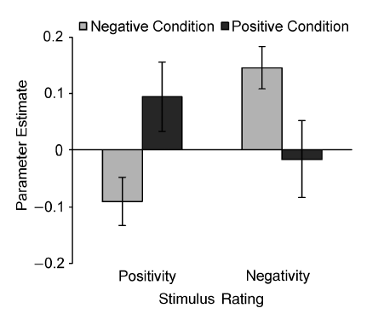

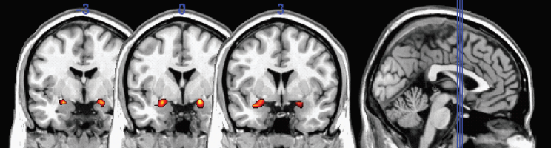
Don Cherry Problem
Cunningham, Van Bavel, & Johnsen, 2008, PS

Slide 24
The Reproducibility Project
But…correlation between original effect size and replication effect size (r = .51)
…approximately ten years later…
…in a different sample.
TAKE HOME: The field of psychology is
about as robust as your personality
Notes:
However, for those of us who study social psychology, the data be interpreted at least a little more positively. In fact, the correlation between the original effect size and replication effect size was moderately strong, a spearman’s correlation of .51 10 years later, and in a different sample. This is actually the same correlation personality psychologists find on average between people’s behavior from one time to another.

